Slide 1

Diggibyte ( Looping constructs in python )

Slide 2
CONDITIONAL AND ITERATIVE STATEMENTS
SEQUENCE
SELECTION
ITERATION

Slide 3
INTRODUCTION
Programs are written for the solution to the real-world problems. A language should have the ability to control the flow of execution so that at different intervals different statements can be executed. Structured programming is a paradigm aims at controlling the flow of execution of statements in a program by using control structures.
A language which supports the control structures is called as structured programming language

Slide 4
TYPES OF CONTROL STRUCTURES

Slide 5
TYPES OF CONTROL STRUCTURES
A Structured programming is an important feature of a programming language which comprises following logical structure:
1. SEQUENCE
2. SELECTION
3. ITERATION OR LOOPING
4. BRANCHING OR JUMPING STATEMENTS

Slide 6
1. SEQUENCE
Sequence is the default control structure; instructions are executed one after another.
Statement 1
Statement 2
Statement 3
……..
……..
……..

Slide 7
1. SEQUENCE – FLOW CHART

Slide 8
1. SEQUENCE – FLOW CHART
Statement 1
Statement 2
Statement 3
SEQUENCE

Slide 9
1. SEQUENCE - PROGRAM

Slide 10
1. SEQUENCE - PROGRAM
Sequence is the default control structure; instructions are executed one after another.
# This program adds two numbers
def sum_of_two_no():
num1 = 1.5
num2 = 6.3
sum = float(num1) + float(num2)
print('The sum is =‘, sum)
sum_of_two_no():

Slide 11
2. SELECTION
SELECTION

Slide 12
2. SELECTION
A selection statement causes the program control to be transferred to a specific flow based upon whether a certain condition is true or not.

Slide 13
CONDITIONAL CONSTRUCT – if else STATEMENT

Slide 14
CONDITIONAL CONSTRUCT – if else STATEMENT
Conditional constructs (also known as if statements) provide a way to execute a chosen block of code based on the run-time evaluation of one or more Boolean expressions. In Python, the most general form of a conditional is written as follows:
Contd.. Next Slide

Slide 15
CONDITIONAL CONSTRUCT – if else STATEMENT
: Colon Must
if first condition:
first body
elif second condition:
second body
elif third condition:
third body
else:
fourth body

Slide 16
CONDITIONAL CONSTRUCT – if else STATEMENT
FLOW aCHART

Slide 17
CONDITIONAL CONSTRUCT – if else STATEMENT
FLOW CHART
Condition ?
False
Statement 1
Statement 2
Main Body
True
Statement 1
else body
Statement 2

Slide 18
CONDITIONAL CONSTRUCT – if else STATEMENT
Each condition is a Boolean expression, and each body contains one or more commands that are to be executed conditionally.
If the first condition succeeds, the first body will be executed; no other conditions or bodies are evaluated in that case.

Slide 19
CONDITIONAL CONSTRUCT – if else STATEMENT
If the first condition fails, then the process continues in similar manner with the evaluation of the second condition. The execution of this overall construct will cause precisely one of the bodies to be executed.
There may be any number of elif clauses (including zero), and
The final else clause is optional.

Slide 20
CONDITIONAL CONSTRUCT – if else STATEMENT
EXAMPLE - PROGRAM

Slide 21
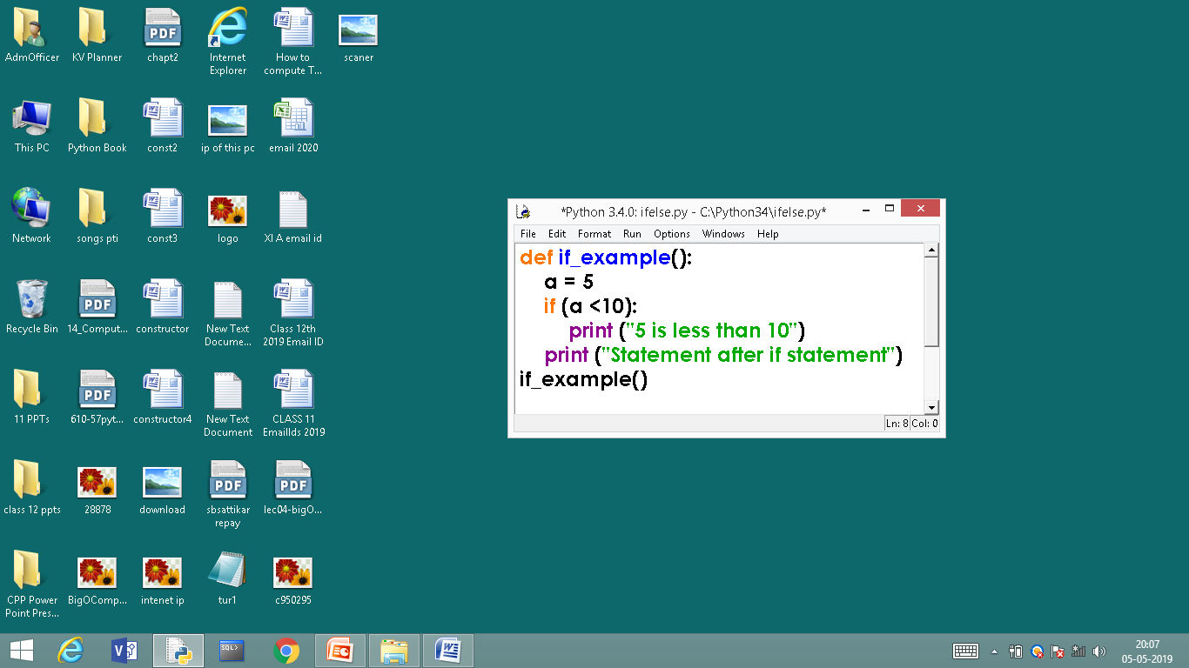
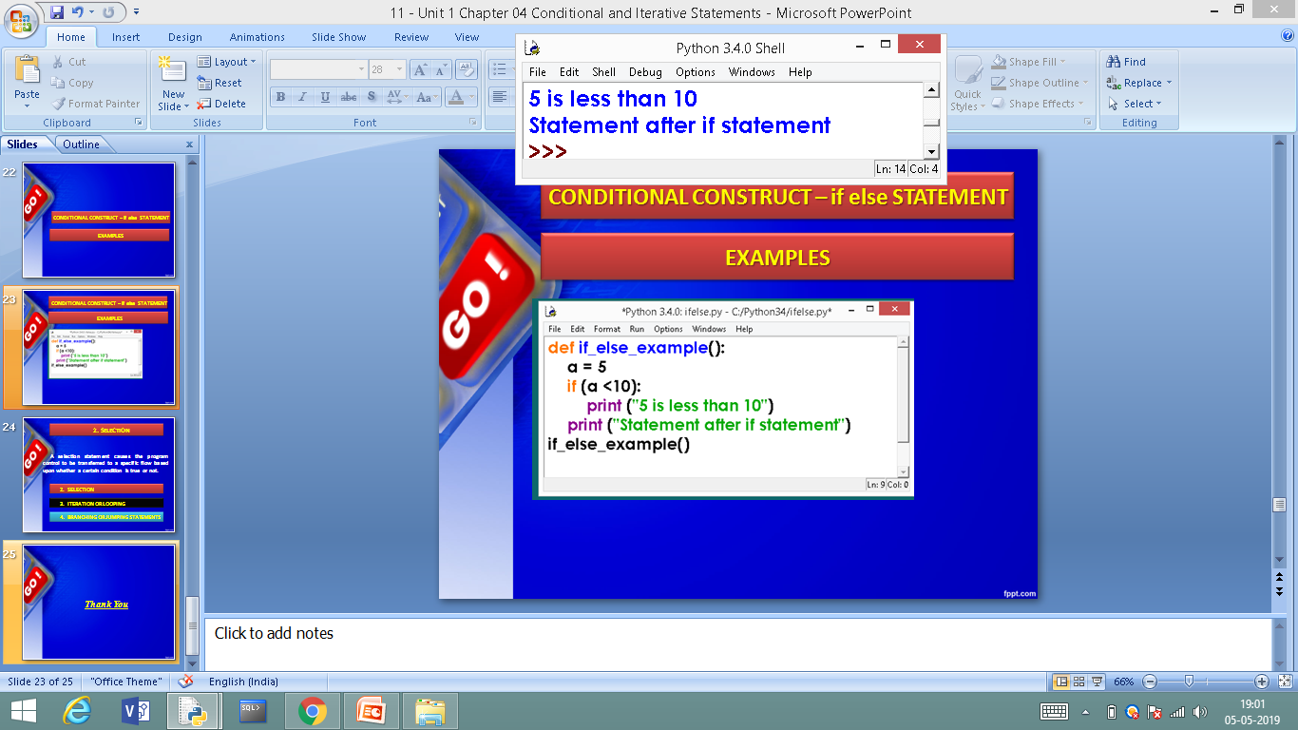
EXAMPLES – if STATEMENT
else is missing, it is an optional statement
OUT PUT

Slide 22
CONDITIONAL CONSTRUCT
EXAMPLE – if else STATEMENT

Slide 23
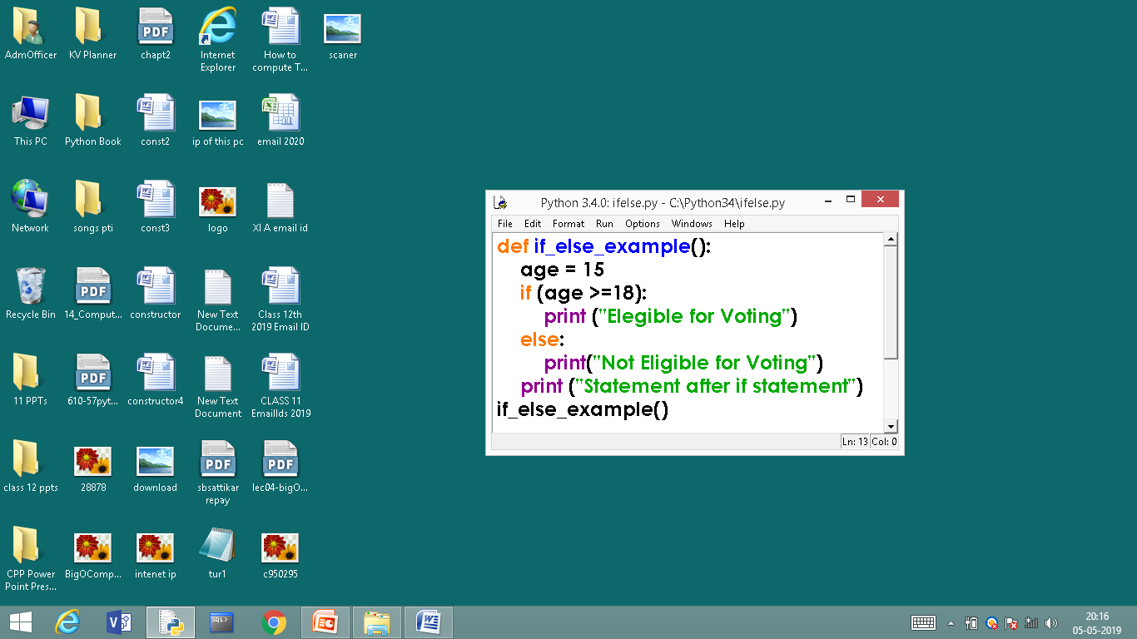
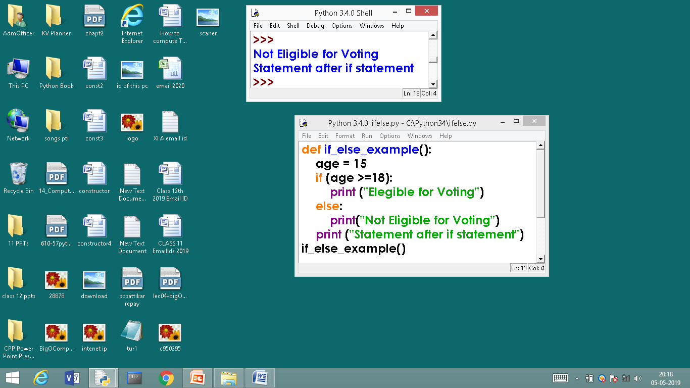
EXAMPLE – if else STATEMENT
: Colon Must
else is used
OUT PUT

Slide 24
CONDITIONAL CONSTRUCT
EXAMPLES – if elif STATEMENT

Slide 25
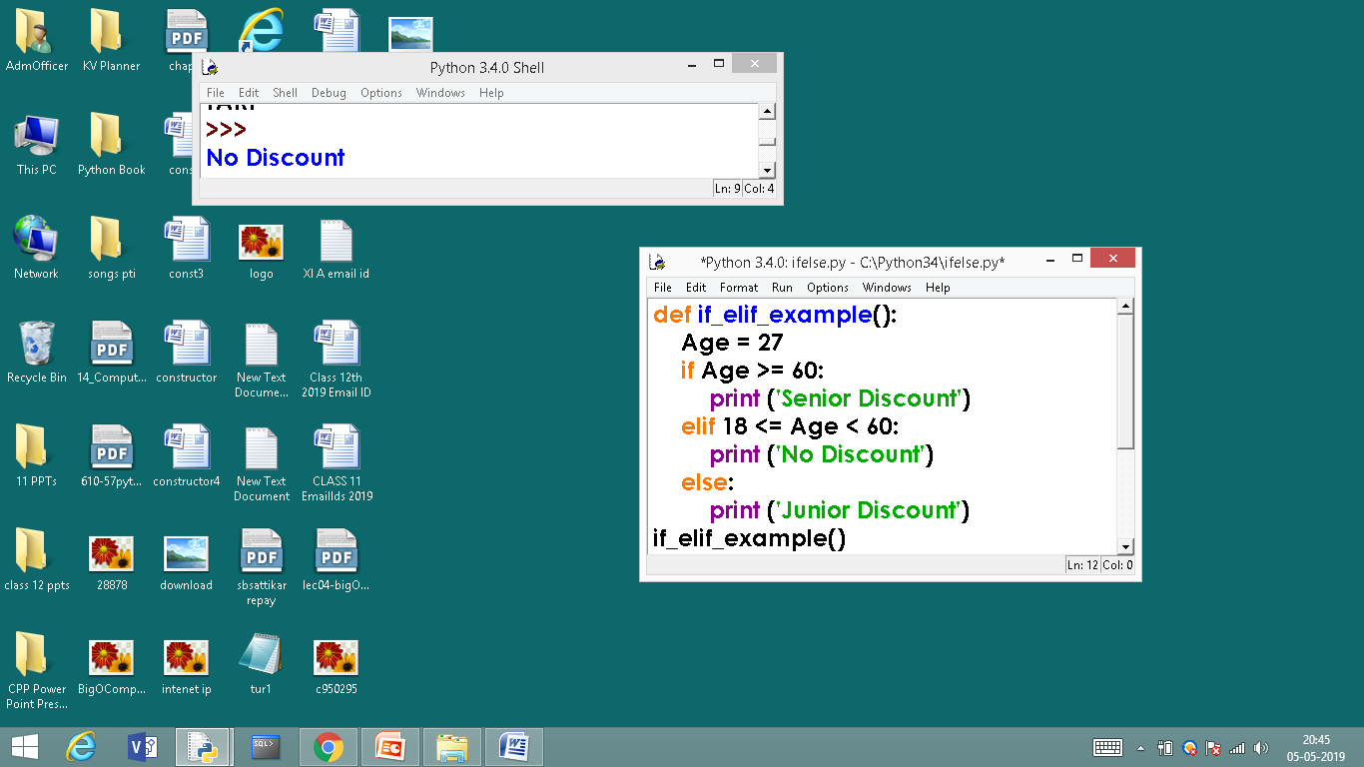
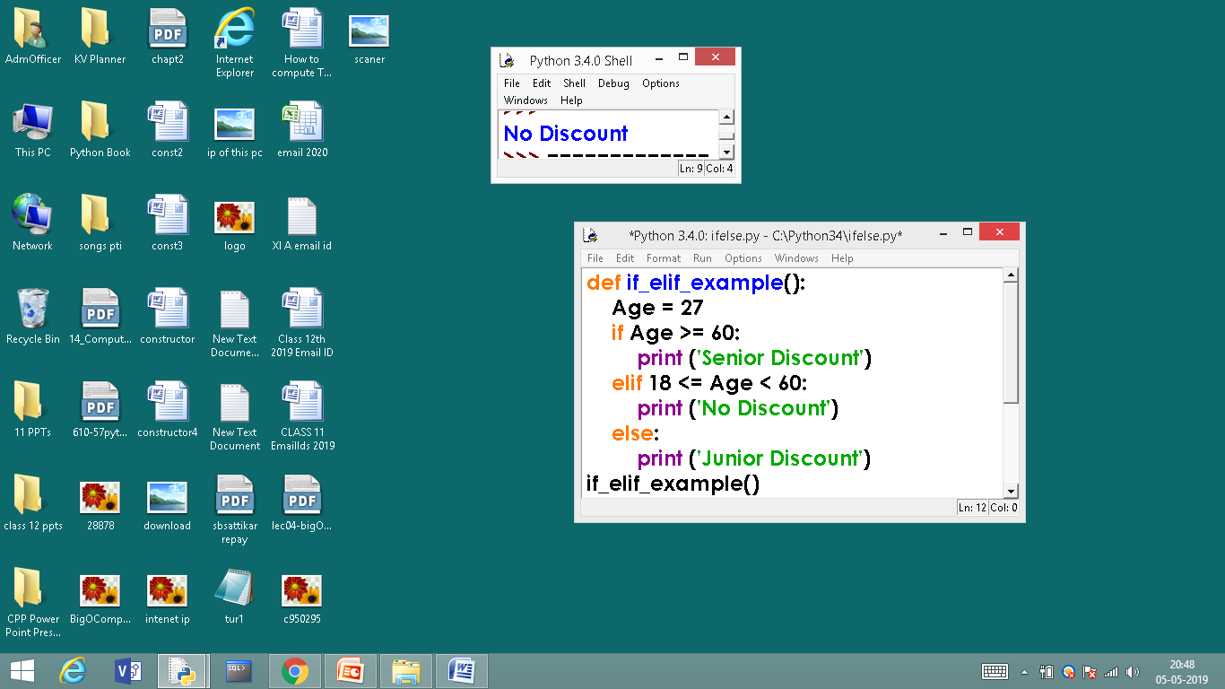
EXAMPLES – if elif STATEMENT
READ AS
18 is less than age
and
18 is less than 60
OUTPUT

Slide 26
3. ITERATION OR LOOPING
ITERATION

Slide 27
3. ITERATION OR LOOPING
What is loop or iteration?
Loops can execute a block of code number of times until a certain condition is met.
OR
The iteration statement allows instructions to be executed until a certain condition is to be fulfilled.
The iteration statements are also called as loops or Looping statements.

Slide 28
3. ITERATION OR LOOPING
Python provides two kinds of loops & they are,
while loop
for loop

Slide 29
while loop

Slide 30
while loop
A while loop allows general repetition based upon the repeated testing of a Boolean condition
The syntax for a while loop in Python is as follows:
while condition:
body
Where, loop body contain the single statement or set of statements (compound statement) or an empty statement.
Contd..
: Colon Must

Slide 31
while loop
The loop iterates while the expression evaluates to true, when expression becomes false the loop terminates.
FLOW CHART
while loop

Slide 32
while loop – Programming example

Slide 33
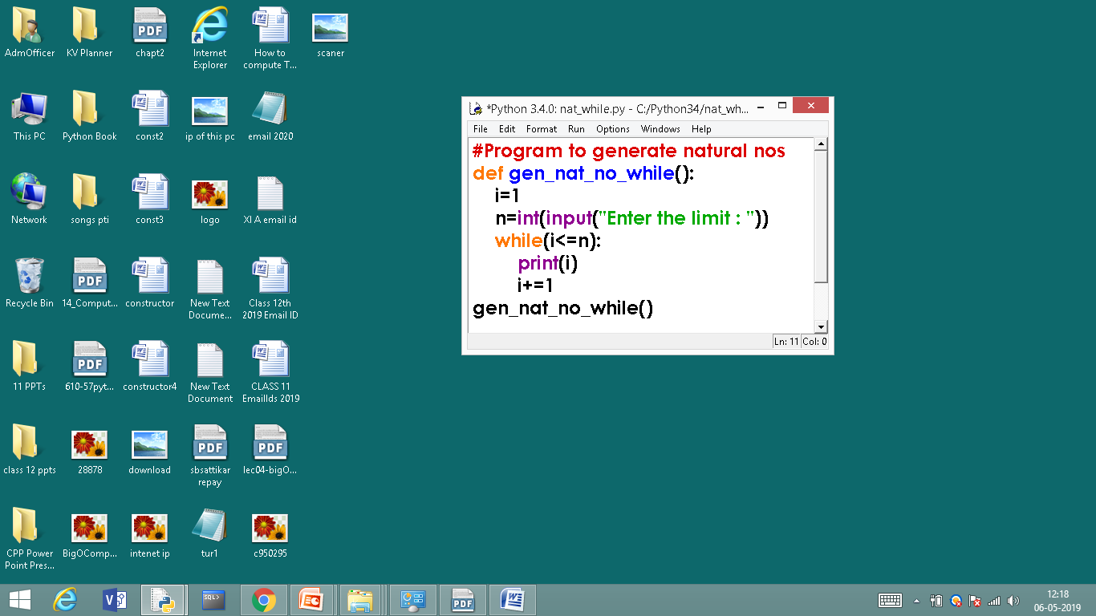
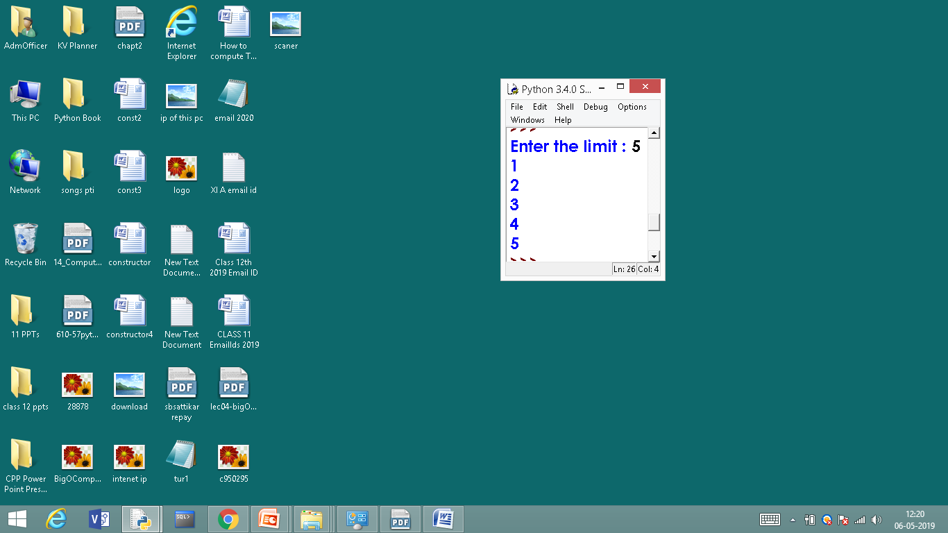
while loop - programs
# Natural Numbers generation
OUTPUT

Slide 34
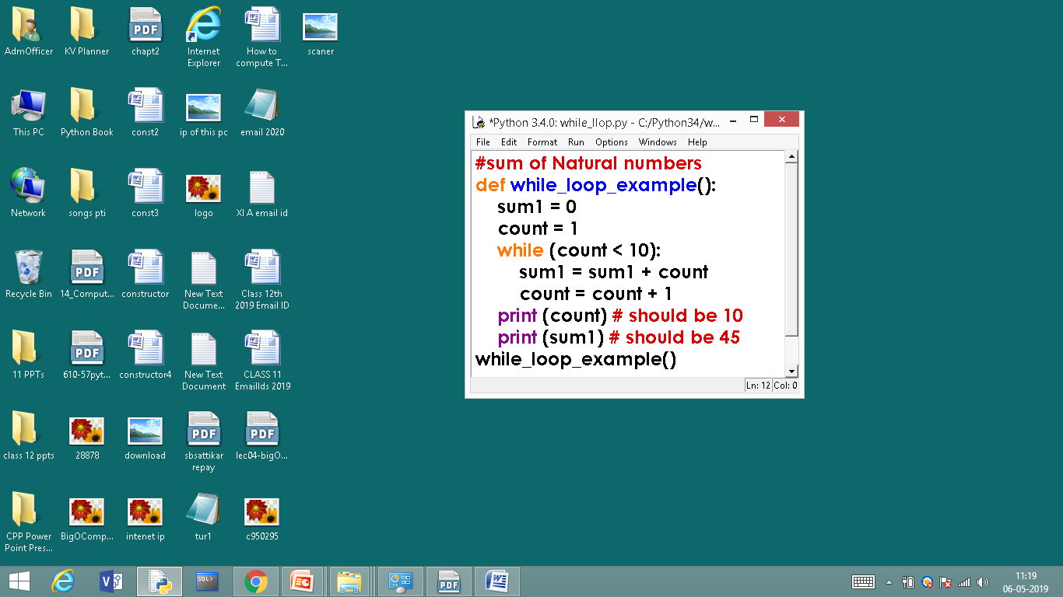
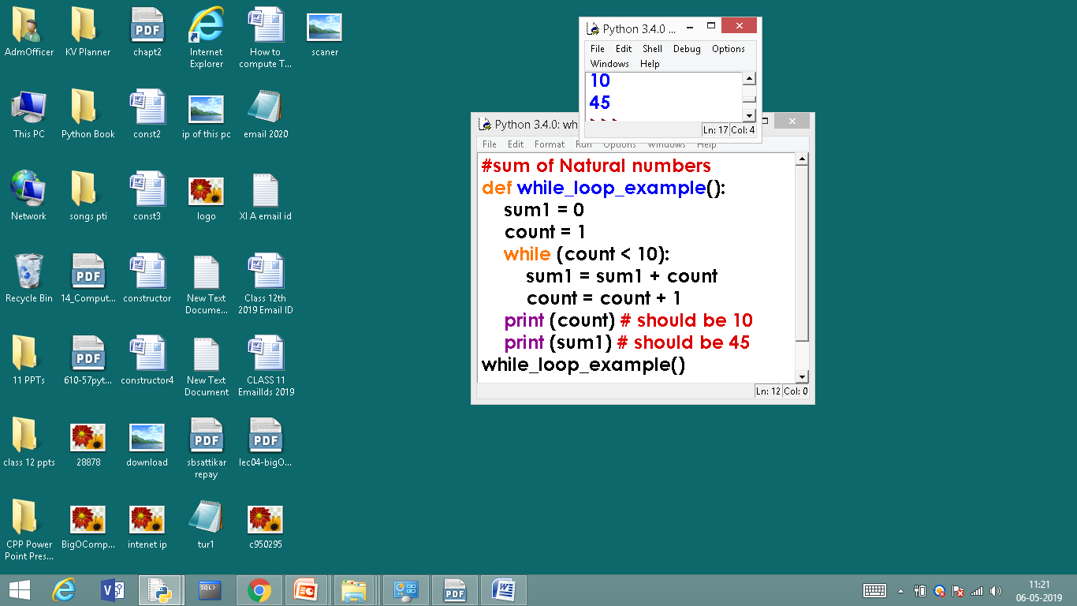
while loop - programs
# Calculating Sum of Natural Numbers
OUTPUT

Slide 35
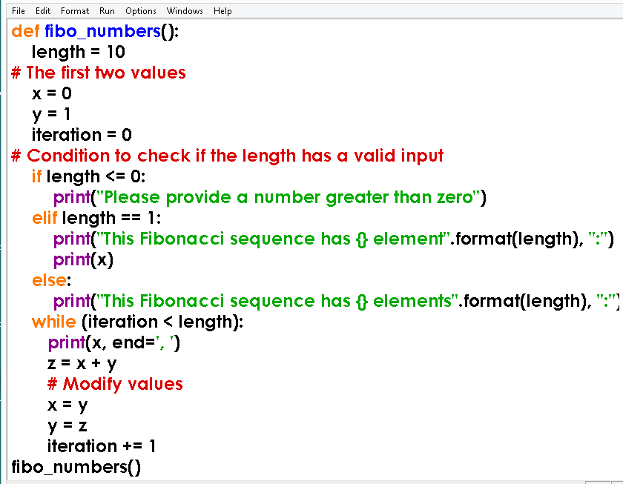
while loop - programs
#Generating Fibonacci numbers

Slide 36
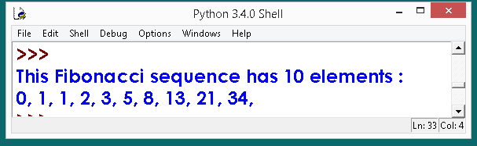
while loop - programs
#Generating Fibonacci numbers
OUTPUT

Slide 37
for LOOP

Slide 38
for LOOP
Python’s for-loop syntax is a more convenient alternative to a while loop when iterating through a series of elements. The for-loop syntax can be used on any type of iterable structure, such as a list, tuple str, set, dict, or file
Syntax or general format of for loop is,
for element in iterable:
body

Slide 39
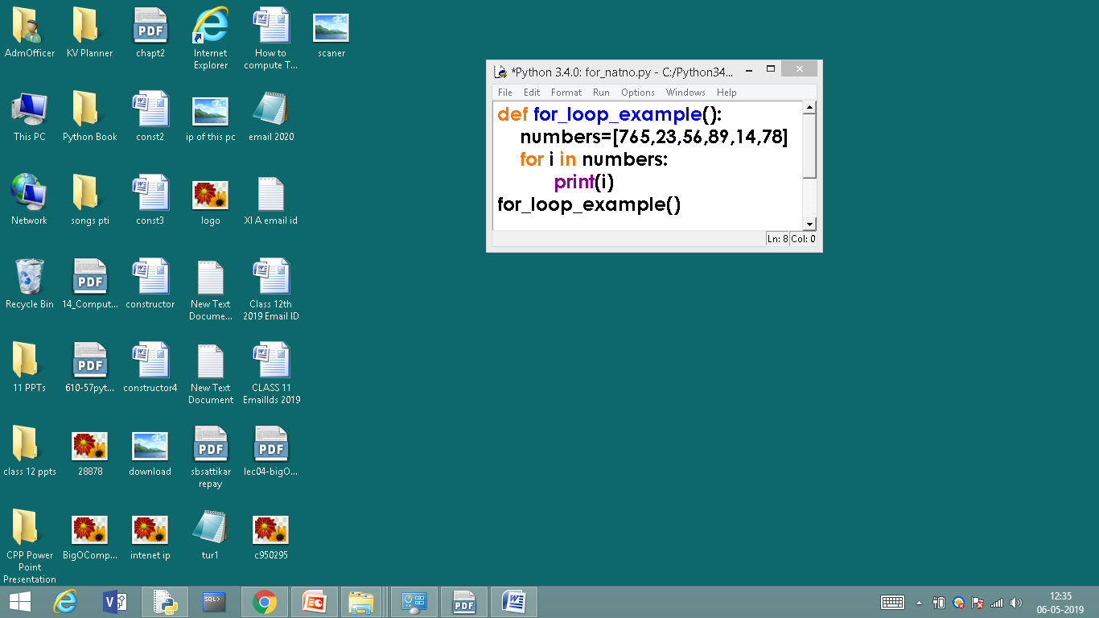
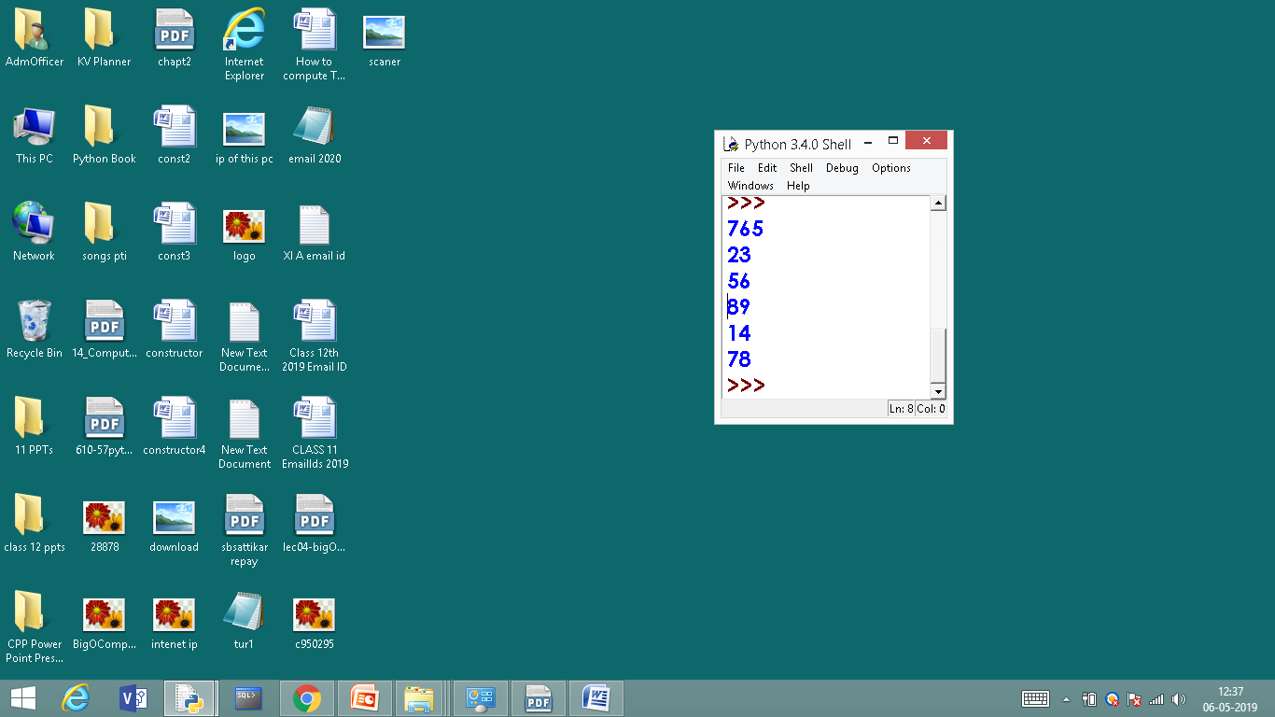
for LOOP
Till the list exhaust for loop will continue to execute.
OUTPUT

Slide 40
for LOOP
range KEYWORD

Slide 41
for LOOP - range KEYWORD
The range() function returns a sequence of numbers, starting from 0 by default, and increments by 1 (by default), and ends at a specified number.
range(start, stop, step)
x = range(3, 6)
for n in x: print(n)
for n in range(3,6): print(n)
OR

Slide 42
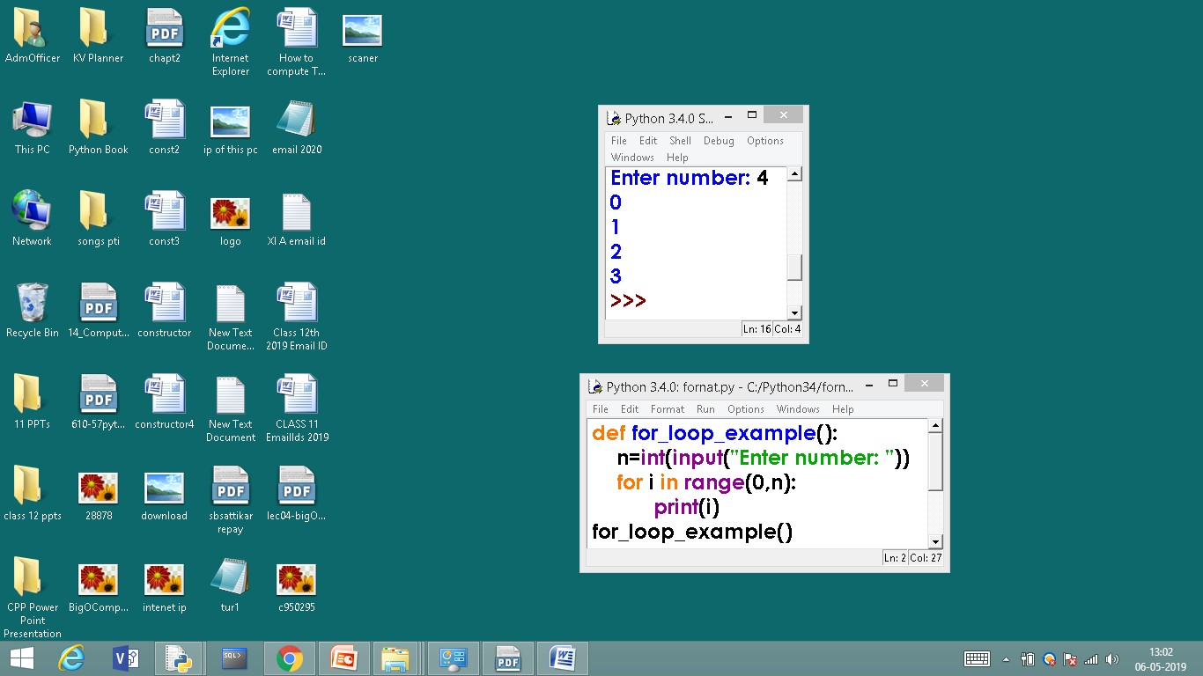
for LOOP - range KEYWORD
#Generating series of numbers
OUTPUT

Slide 43
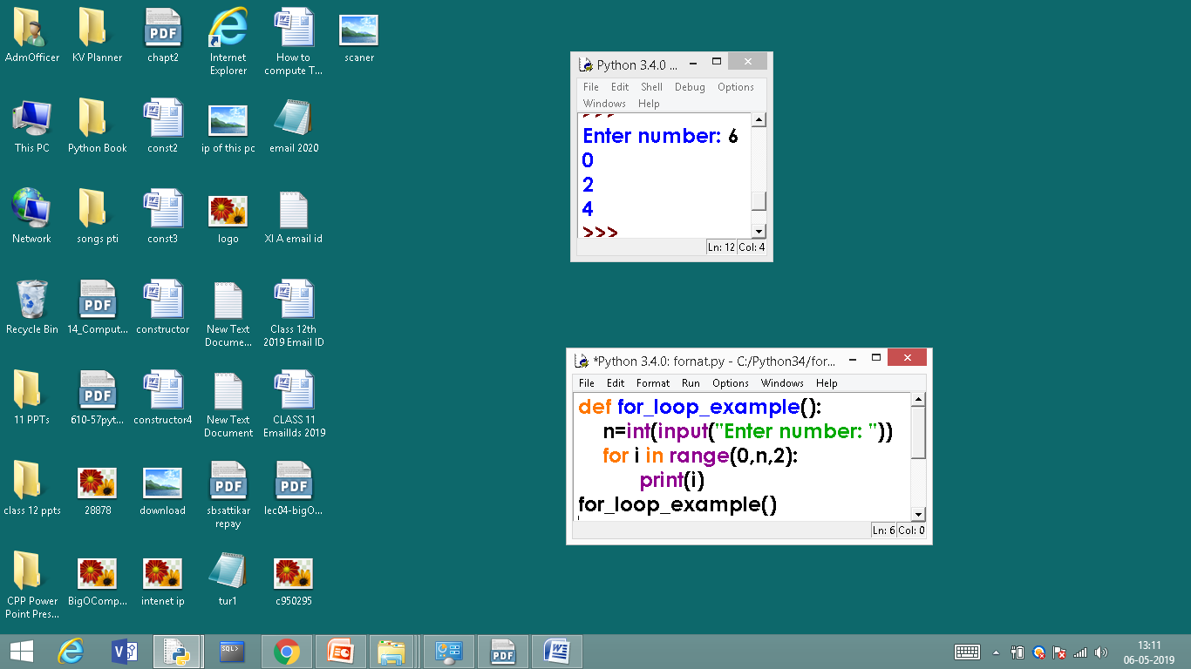

for LOOP - range KEYWORD
#Generating even numbers
OUTPUT

Slide 44
for LOOP – len() FUNCTION

Slide 45
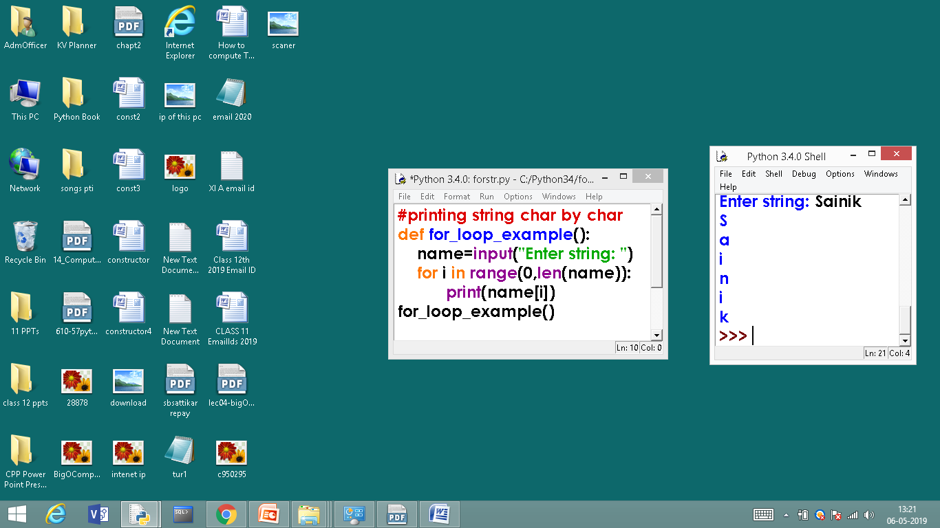
for LOOP - range KEYWORD
# print string character by character
OUTPUT

Slide 46
else statement in loop

Slide 47
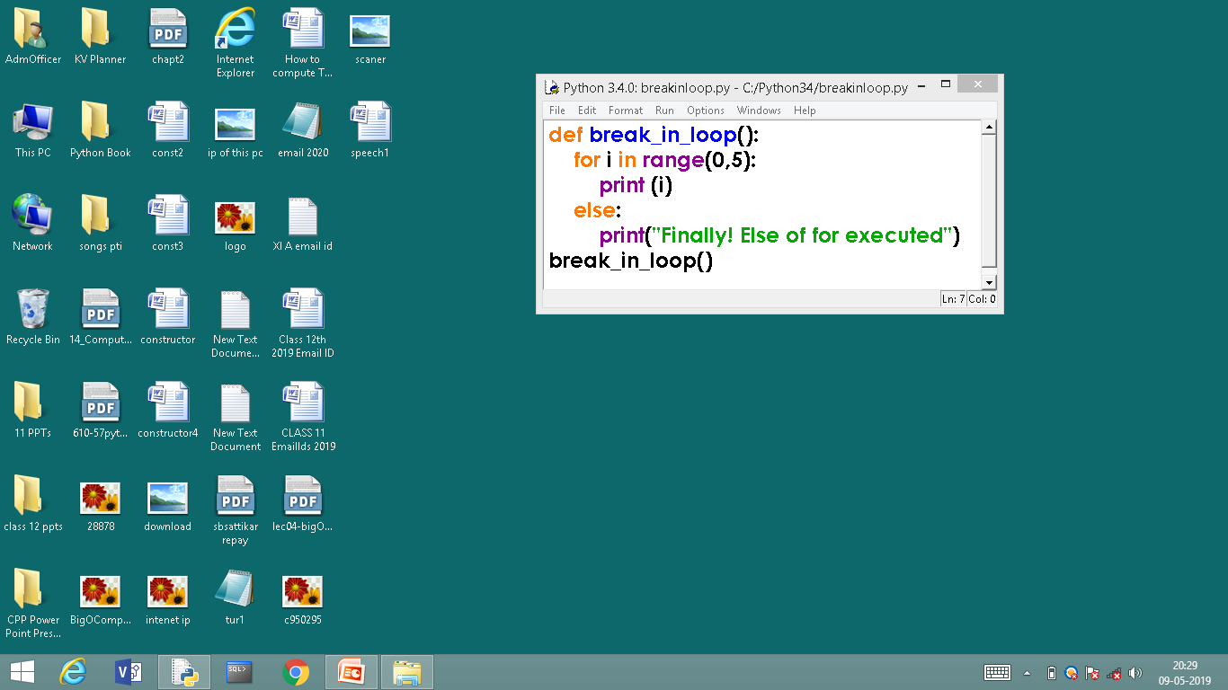
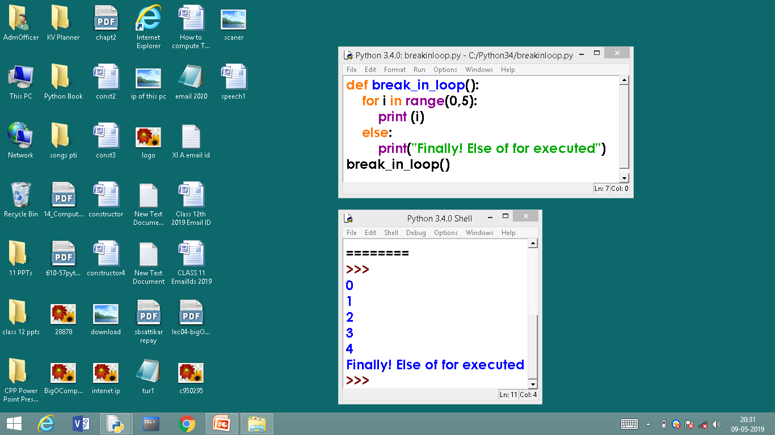
else statement in loop
else can be used in for and while loops the else body will be executed as and when the loop’s conditional expression evaluates to false
OUTPUT

Slide 48
4. BRANCHING OR JUMPING STATEMENTS

Slide 49
4. BRANCHING OR JUMPING STATEMENTS
Python has an unconditional branching statements and they are,
1. break STATEMENT
2. continue STATEMENT

Slide 50
4. BRANCHING OR JUMPING STATEMENTS
1. break STATEMENT
Break can be used to unconditionally jump out of the loop. It terminates the execution of the loop. Break can be used in while loop and for loop. Break is mostly required, when because of some external condition, we need to exit from a loop.

Slide 51
1. break STATEMENT
Condition ?
Loop
break causes jump
True
Statement 1
break

Slide 52
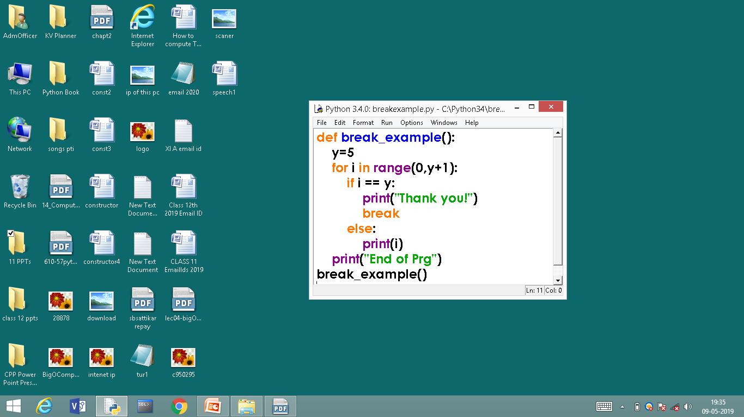
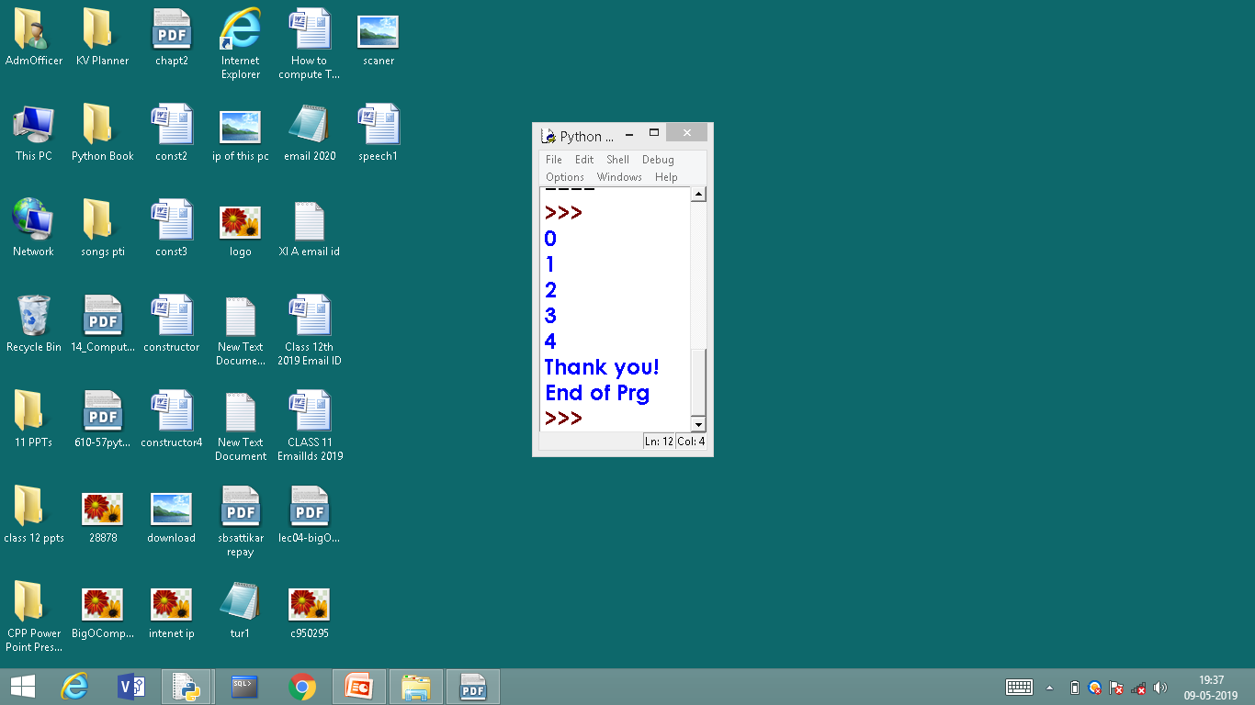
1. break STATEMENT
OUT PUT

Slide 53
2. continue STATEMENT
The continue statement in Python returns the control to the beginning of the while loop. The continue statement rejects all the remaining statements in the current iteration of the loop and moves the control back to the top of the loop. The continue statement can be used in both while and for loops.

Slide 54
2. continue STATEMENT
Condition ?
Loop
False
True
Statement 1
Statements ignored or skipped
continue
continue causes jump
Statement n

Slide 55
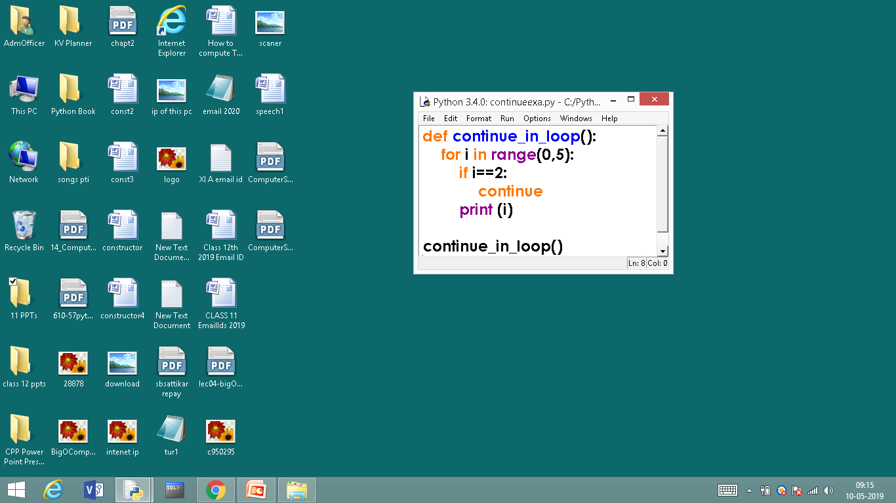
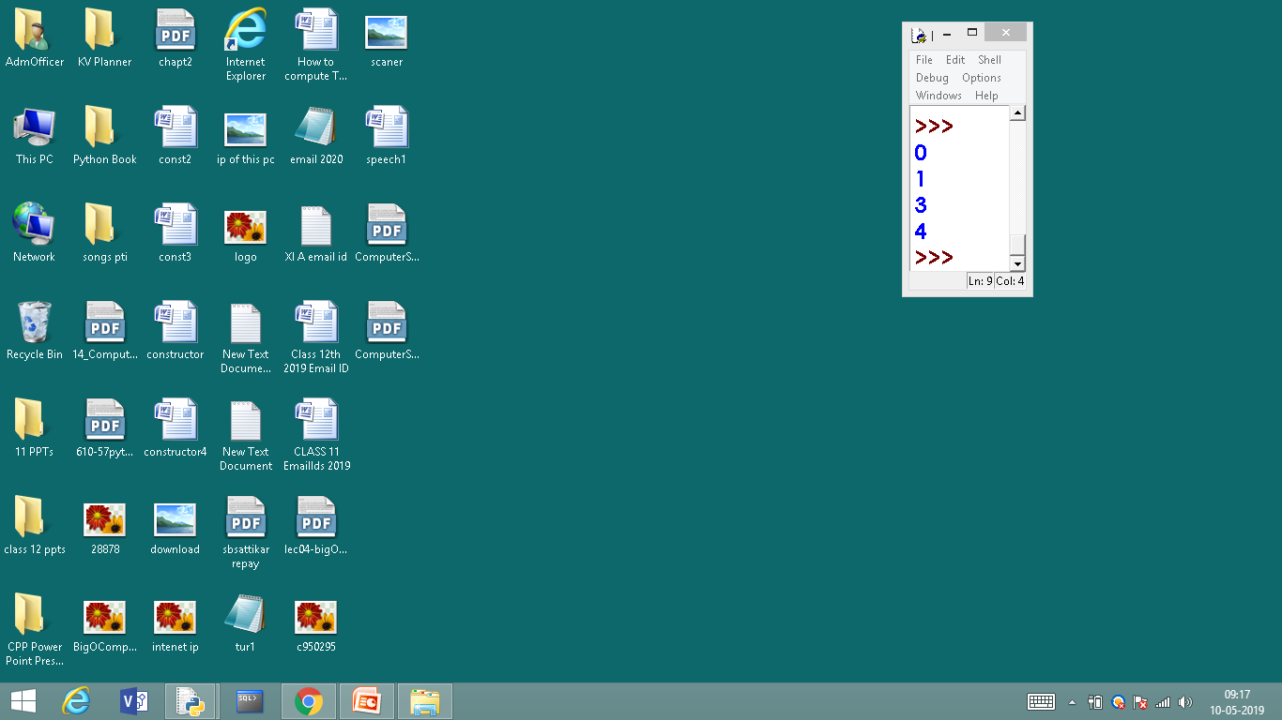
2. continue STATEMENT
when i value becomes 2 the print statement gets skipped, continue statement goes for next iteration, hence in the out put 2 is not printed

Slide 56
pass STATEMENT

Slide 57
pass STATEMENT
The pass statement in Python is used when a statement is required syntactically but you do not want any command or code to execute.
The pass statement is a null operation; nothing happens when it executes.
The pass is also useful in places where your code will eventually go, but has not been written yet (e.g., in stubs for example):

Slide 58
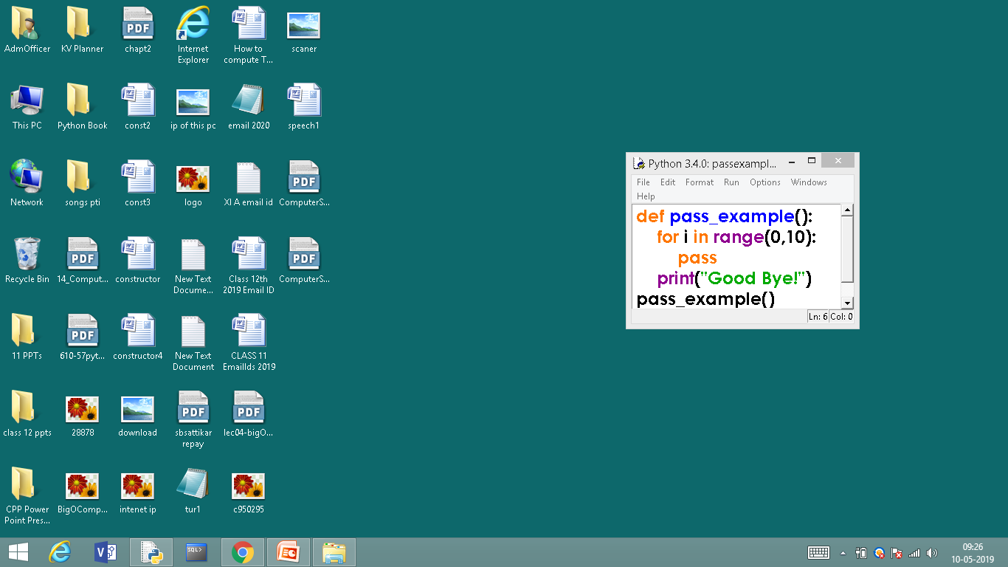
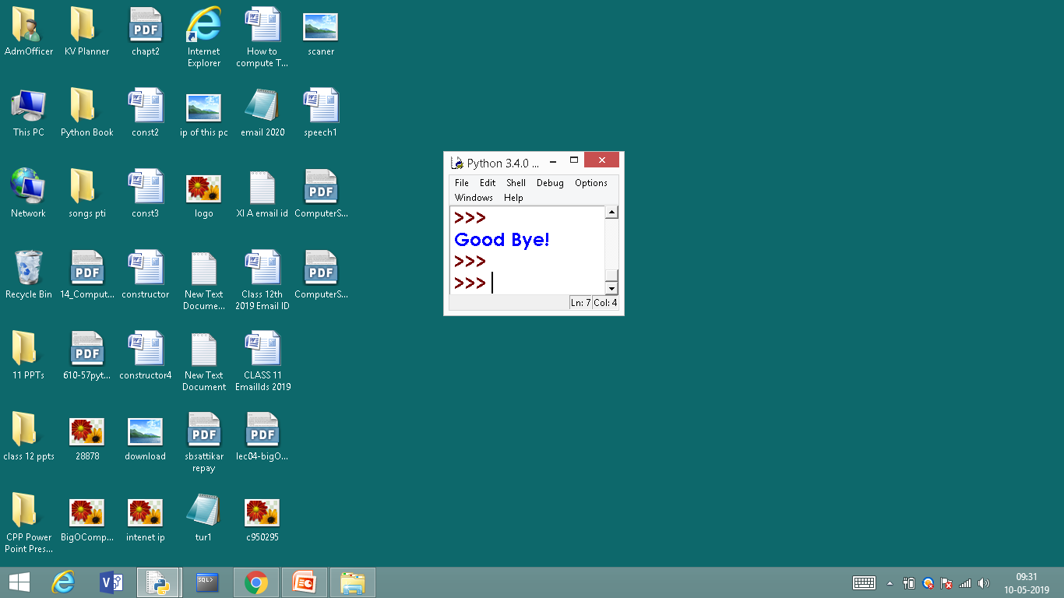
pass STATEMENT
pass in loop has no output
pass in loop

Slide 59
Difference Between break and continue
break
continue

Slide 60
Difference Between break and continue
BREAK | CONTINUE
It terminates the execution of remaining iteration of the loop. | It terminates only the current iteration of the loop.
'break' resumes the control of the program to the end of loop enclosing that 'break'. | 'continue' resumes the control of the program to the next iteration of that loop enclosing 'continue'.
It causes early termination of loop. | It causes early execution of the next iteration.
'break' stops the continuation of loop. | 'continue' do not stops the continuation of loop, it only stops the current iteration.

Slide 61
Thank You

Slide 62






LET’S CONNECT
info@diggibyte.com
www.diggibyte.com
+91 81108 89199
Novel Tech Park, Ground Floor, Kudlu Gate, Bengaluru, Karnataka.
Pin Code: 560068

